Slide 1

From Idea to Execution
How to Plan Your
Final Project
"If You Fail to Plan, You Are Planning to Fail" - Benjamin Franklin

Slide 2
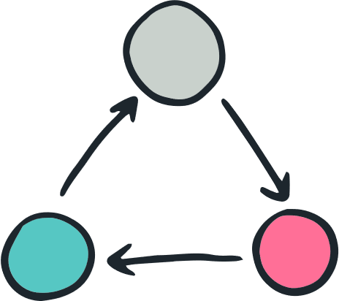


Why Planning Matters
✅ Saves time and prevents unnecessary rewrites. ✅ Helps define a clear goal before coding. ✅ Ensures a structured and scalable project. ✅ Makes collaboration easier.
💡 Think before you code!

Slide 3
The Planning Process
Step 1
Step 2
Step 3
Define the Project Idea
Break It Down into Features
Wireframe & Database Schema
Step 4
Step 5
Create a To-Do List
Set Up the Project & Start Coding

Slide 4
Introducing the User Problem
💡 Scenario: A local gym wants a web app where members can:
Register & log in
Track their workouts
View progress over time
🤔 How would you plan this project?

Slide 5
Step 1 - Define the Project Idea
📌 Ask yourself:
What problem does the project solve?
Who is the target audience?
What is the goal of the app?
📝 Activity: Write a one-sentence project goal for the gym app. Example: “A web app that allows gym members to register, log workouts, and track progress.”

Slide 6
Step 1 - Define the Project Idea
📌 Ask yourself:
What problem does the project solve?
Who is the target audience?
What is the goal of the app?
📝 Activity: Write a one-sentence project goal for the gym app. Example: “A web app that allows gym members to register, log workouts, and track progress.”

Slide 7
Step 2 - Break It Down into Features
👀 Identify Core Features (MVP): ✅ User authentication (signup/login) ✅ Workout logging (date, exercises, sets, reps) ✅ Progress tracking
💡 Extra Features: ➕ Social sharing ➕ Personalized workout recommendations
📝 Activity: List 3-5 must-have features.

Slide 8
Step 3 - Wireframe & Database Schema
🖍️ Wireframing (UI Design)
Homepage
Workout logging page
Profile page
📊 Database Schema (MongoDB Collections)
Users (name, email, password)
Workouts (userID, exercises, date)
Progress (weight, reps, time)
📝 Activity: Sketch a quick wireframe & list key collections.

Slide 9
Step 5 - Setting Up the Project
Step 5 - Setting Up the Project
💻 Before Writing Code: ✔️ Create a GitHub repo ✔️ Set up folder structure ✔️ Install dependencies (Express, MongoDB, React, Node) ✔️ Make the first commit
🚀 Now you’re ready to start coding!

Slide 10







